Slide 1
Chapter 12 Emission Taxes and Subsidies

Slide 2
Learning Objectives
LO1 Explain and show graphically how a polluter responds to an emission tax set by the government regulator and show how to calculate the polluter’s compliance costs.
LO2 Derive the socially efficient tax rate and illustrate graphically the costs to the polluter, the benefits to society, and the net social benefits.
LO3 Prove that any tax rate set by the government is cost efficient.
LO4 Explain how an emission tax differs from a uniform standard in terms of social compliance costs and cost effectiveness.
LO5 Contrast the impact of an emission tax with that standards with respect to government revenues, incentives to innovate, enforcement costs, and distributional impacts.
LO6 Explain how an emission subsidy works and how it differs from an emission tax.

Slide 3
Carbon Tax in Canada
https://globalnews.ca/news/4291256/carbon-tax-do-they-work/

Slide 4
Emission Tax
The essence of the tax approach is to provide an incentive for the polluters themselves to find the best way to reduce emissions, rather than having a central authority determine how it should be done.
Example: the British Columbia government has imposed a carbon tax in 2008 on over 75 percent of the greenhouse gases emitted in the province as a means of reducing carbon dioxide emissions and ameliorating global warming.
Once pollution is “priced” by the tax, those who release it will have an incentive to release less of it to avoid paying the tax.
LO1

Slide 5
Calculating the Total Polluter’s Costs
Suppose MAC = 200 – 4E
Pollution Tax: $100 per tonne
Total Polluter’s Costs = Total Abatement Costs + Total Tax Bill
Fill out the handout

Slide 6
The Basic Economics of an Emission Taxes
LO1

Slide 7
Tax and Emissions
$
$200
MAC = 200 – 4E
Tax = $100/tonne
a
b
25
50 (E0)
Emissions (tonnes/month)

Slide 8
The Basic Economics of Emission Taxes
The numbers refer to a single source of a particular pollutant who has a marginal abatement cost function of MAC=200 - 4E.
With no regulation, the polluter emits at E0 50 tonnes/month and pays a tax bill of $5,000 (i.e., 50 tonnes times $100); if it were to cut emissions to 45 tonnes it would cost $50 in abatement costs, but on the other hand it would save $500 in taxes—clearly a good move. Following this logic, it could improve its bottom line by continuing to reduce emissions as long as the tax rate is above marginal abatement costs.
This is shown graphically as the point where the tax rate intersects the polluter’s MAC curve. Area a is the tax bill; area b shows the total abatement costs

Slide 9
The Cost of Pollution
After the polluter has reduced its emissions to 25 tonnes/month, its total (monthly) tax bill will be $2,500. Its monthly abatement costs will be $1,250.
Graphically, total abatement costs correspond to the area under the marginal abatement cost function, labelled b in the figure. The total tax bill is equal to emissions times tax rate, or the rectangle labelled a. Total private cost is thus area ( a + b ).
Emission taxes raise the costs of the firm. Therefore, to maximize profits, the firm must do whatever it can to minimize its total costs inclusive of the emission taxes.
LO1

Slide 10
The Socially Efficient Tax
In competitive situations, higher taxes will bring about greater reductions in emissions, but just how high should the tax be set?
If we know the marginal abatement cost (MAC) and marginal damage (MD) function, the economist’s answer is to set the tax so as to produce the efficient level of emissions, as in Figure 12-2 on the next slide.
LO2

Slide 11
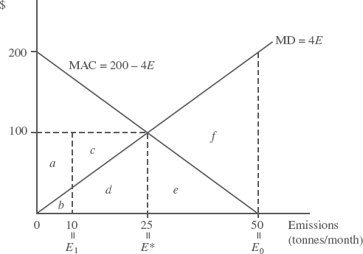
A Socially Efficient Emission Tax
The socially efficient equilibrium is reached with a tax set equal to $100 per tonne.
This is the “price” at which MD MAC. The polluter’s private costs of compliance are its total tax bill paid, area ( a + b + c + d ), plus its total abatement costs, area e.
Total social costs of compliance are just the TAC. The net benefit of the tax is the total damages forgone, area ( e + f ) net of TAC. This is area f.
LO2

Slide 12
Private and Social Costs
In the Figure, private costs are, respectively, area e which is 1/2[(100x25)] = $1250, plus the tax bill which is, areas ( a + b + c + d ) and totals $3750.
However private costs of compliance do not represent the real resource cost society incurs as a result of levying the emission tax. It is social costs that society is interested in.
Taxes are actually transfer payments, payments made by the polluters to the public sector and eventually to those in society who are benefited by the resulting public expenditures.
The polluter itself may be a recipient of some of these benefits. Transfer payments are therefore not a social cost of the policy. Thus, the social costs of compliance are area e, the polluter’s total abatement costs.
LO2

Slide 13
Net Cost to Society
Net social benefits of a policy are defined as the total damages forgone net of the social costs of compliance.
The reduction of emissions from E0=50 to E*=25 tonnes per month has eliminated damages of (e + f) which are the net gains to victims, given by the difference between areas (b + d + e + f) minus (b + d) = $3750.
Remaining damages are (b + d), an amount less than the firm pays in taxes.
This underscores the idea that the emission tax is based on the right to use environmental resources, not on the notion of compensation.
LO2

Slide 14
Emission Taxes and Cost-Effectiveness
The imposition of an emission tax will automatically satisfy the equimarginal principle because all polluters will set the tax equal to their MAC curve. MACs will be equalized across all sources.
Assume pollution comes from two sources, plants H and L, and that emissions are uniformly mixed, so that the emissions of the two plants are equally damaging in the downstream, or downwind, impact area.
LO3

Slide 15
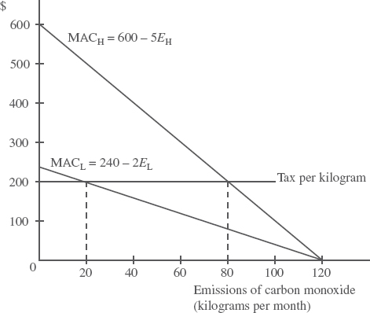
Emission Taxes Are Cost-Effective
A uniform emissions tax of $200 per kilogram of carbon monoxide released is cost effective. Both polluters set the tax equal to their MAC curve. H reduces emissions to 80 kilograms; L to 20 kilograms per month.
Under the Emission Tax ($200/t):
(Total Emission: 100kg/month)
TAC(H) = ?
TAC(L) = ?
Under the Uniform Standard (50kg/month):
(Total Emission: 100kg/month)
TAC(H) = ?
TAC(L) = ?

Slide 16
Uniform Standards and Emission Taxes
When MACs differ among polluters, social compliance costs are lower under a tax than a uniform standard (meeting the same target level of emissions) because the tax is cost-effective and the uniform standard is not (see also Slide 12 in Lecture Note – Ch11).
An emission tax is cost-effective even if the regulator knows nothing about the marginal abatement costs of any of the sources.
This is in clear contrast with the standards approach, where the public agency has to know exactly what these marginal abatement costs are for each firm in order to have a fully cost-effective program—that is, individual standards.
LO4

Slide 17
Let’s check what we’ve learned.
Socrative.com
Room: 814957

Slide 18
Emission Taxes vs Standards: Innovation
One of the main advantages of emission taxes is that they provide strong incentives for investing in new technologies that have lower marginal abatement costs for controlling emissions.
Two key differences between incentives to innovate under taxes versus standards are as follows:
The firm’s R&D efforts will lead to a bigger reduction in its pollution-control-related costs (abatement costs plus tax payments) under a policy of emission taxes than under a standards approach.(See the graph)
Under the tax system the firm would automatically reduce its emissions as it found ways to shift its marginal abatement cost function downward, whereas under the standard no such automatic process would result.
LO5

Slide 20
Emission Taxes vs Standards: Enforcement Costs
Any tax system requires accurate information on the item to be taxed. If emissions are to be taxed, they must be measurable at reasonable cost.
If the tax is on emissions per day, while a standard is based on annual emissions, the tax policy will have higher enforcement costs.
It is possible that monitoring must be done on exactly the same basis to ensure compliance with the tax or the standard making the enforcement costs nearly identical.
LO5

Slide 21
Emission Taxes vs Standards: Government Revenues
Taxes have another potential advantage over standards and subsidies—tax revenue is collected.
Economists have advocated using emission tax revenues to reduce other taxes that provide disincentives to work, save, and invest in the economy; taxes such as on payrolls, income, and investment.
The pollution tax revenue is used to reduce other taxes, there will be no net gain in the size of government (net of any tax collection costs).
LO5

Slide 22
Emission Taxes vs Standards: Distributional Impacts
There are two primary impacts of effluent taxes on the distribution of income and wealth:
Impacts on prices and output of goods and services affected by the tax
Effects stemming from the expenditures of revenues generated by the tax

Slide 23
Emission Taxes vs Standards: Distributional Impacts
If the tax is applied to an entire industry, then prices will go up and consumers will bear part of the burden.
Price increases are often thought of as regressive
If emission tax revenues are recycled back to the community in the form of tax cuts and credits, much of the impact on low-income people can be mitigated.
- For example, B.C.’s carbon tax cuts the personal income tax rates to the first two tax brackets by 5 percent and provides a tax credit of just over $100 per adult and $30 per child each year to low-income households.

Slide 24
Practice exercise
Suppose a polluting firm has MAC = 400 - ½ E. Calculate the firm's level of emissions, abatement and total compliance cost if it faced an effluent fee of $120 per unit of emissions.

Slide 25
Emission Subsidies
A subsidy acts as a reward for reducing emissions. More formally, it acts as an opportunity cost: when a polluter chooses to emit a unit of effluent, they are in effect forgoing the subsidy payment they could have had if they had chosen to withhold that unit of effluent instead.
The regulator pays a subsidy for each unit by which the polluter reduces its emissions, starting from a base level.
LO6

Slide 26
Emission Taxes and Emission Subsidies
Many of the points we made earlier about emission taxes also apply to emission subsidies. The job of monitoring emissions would be essentially the same except for difficulties in determining base levels.
To be able to pay subsidies to polluters, governments will have to raise revenue in some way. The extra revenue needed for subsidies could come from more government debt, higher income or sales taxes, and so on.
LO6

Slide 27
Chapter Overview
Emission taxes attack the pollution problem at its source, by putting a price on something that has been free and, therefore, overused. The main advantage of emission taxes is their efficiency aspects: If all sources are subject to the same tax, they will adjust their emission rates so that the equimarginal rule is satisfied.
Standards have the appearance of placing direct control on the thing that is at issue, namely emissions. Emission taxes, on the other hand, place no direct restrictions on emissions but rely on the self-interested behaviour of firms to adjust their own emission rates in response to the tax.

